Slide 1

Digital Solutions
IA1 – Technical Proposal
Riley Hampson

Slide 2

Climate Facts
Technical Proposal
A Web Application

Slide 3
Contents
Task Information:
Task Breakdown (Mind Map)
Constraints
Criteria
Technical Proposal:
Introduction
User Story (& Existing Solutions)
Data Story (& Datasets & Data Dictionary)
Proposed Solution
Conclusion

Slide 4
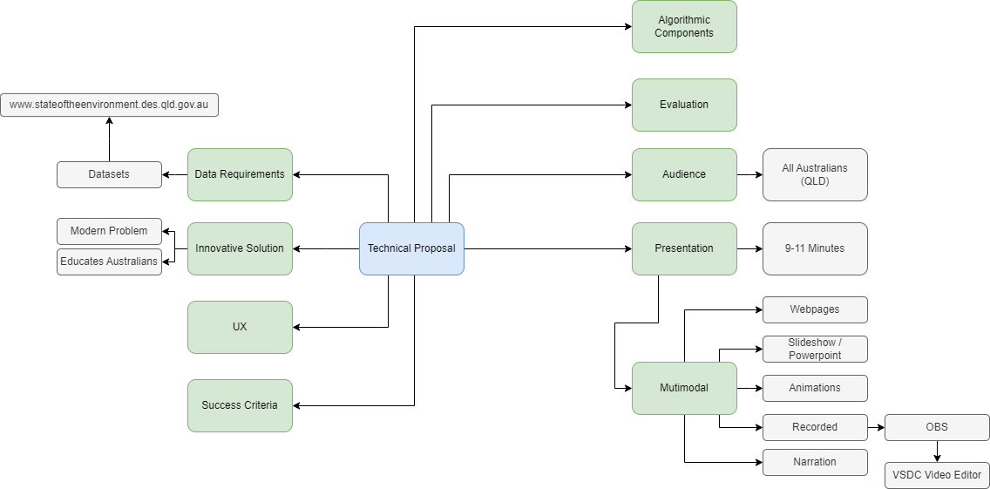
Task Breakdown

Slide 5
Constraints
Time – The technical proposal must be completed for the Queensland Government Department of Environment and Science by the 26th of February 2024 at 8:30 am
Data – The data must be sourced from the QLD Department of Environment and Science page: (www.stateoftheenvironment.des.qld.gov.au). Authorised users must be able to upload Greenhouse Gas Emissions data
Legal – Any resources used throughout this document, the technical proposal and the proposed solutions must be publicly accessible under Creative Commons 4.0 attribution
Communication – The Technical proposal must be presented through a multimodal presentation

Slide 6
Criteria
Prescribed
By Monday, the 26th of February 2024 at 8:30 am:
Produce a technical proposal for an innovative Digital Solution and present its feasibility through a multimodal presentation
Develop a low-fidelity prototype of a responsive web application for the Department of Environment and Science (DES) about greenhouse gas emissions
Analyse two datasets provided by DES and determine the most suitable for the web application
Allow Authorised Users (System Administrators) to upload greenhouse gas emissions data
Be able to generate reports to display sector data and historical totals for Queensland
Compare Gas emissions between states for 2018
Self-Determined
By Monday, the 26th of February 2024 at 8:30 am:
Design a mock-up/prototype user interface (UI) with appropriate accessibility features to ensure accessibility and a good user experience (UX)
Create effective and efficient Algorithms by using selection and iteration to present selected data
Allow Climate data to be uploaded in .csv file format
Develop a prototype of a normalised 3NF mySQL database with accurate and appropriate Primary and Foreign key Relationships
Present accurate, relevant data in an easily accessible and unbiased manner

Slide 7
Introduction

Slide 8

Introduction
“Avoid, minimise or mitigate impacts to the environment.”
The State of Queensland. (2017). State of the Environment (Department of Environment and Science). Qld.gov.au. https://www.stateoftheenvironment.des.qld.gov.au/

Slide 9
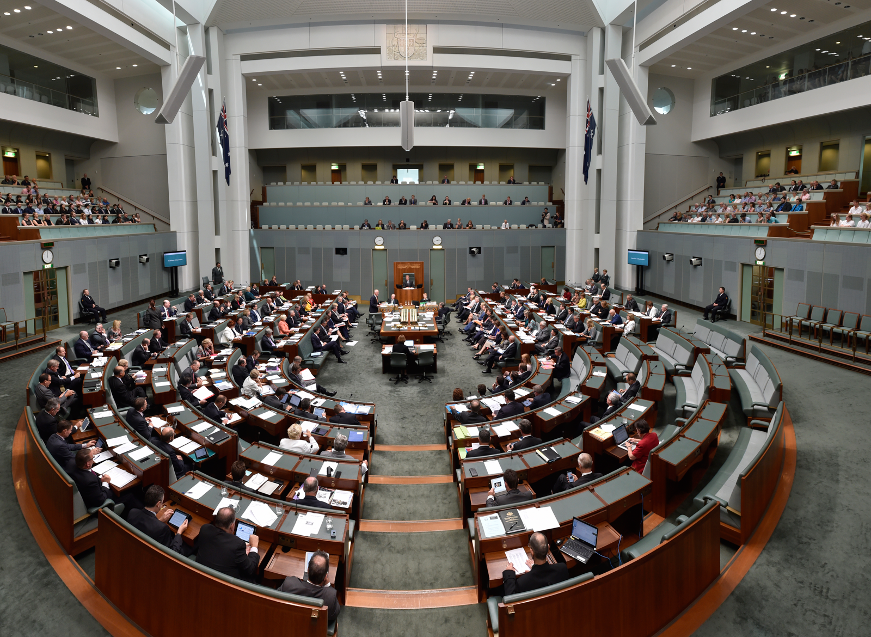

Misinformation & Disinformation

Slide 10
User Story

Slide 11

User Story

Slide 12
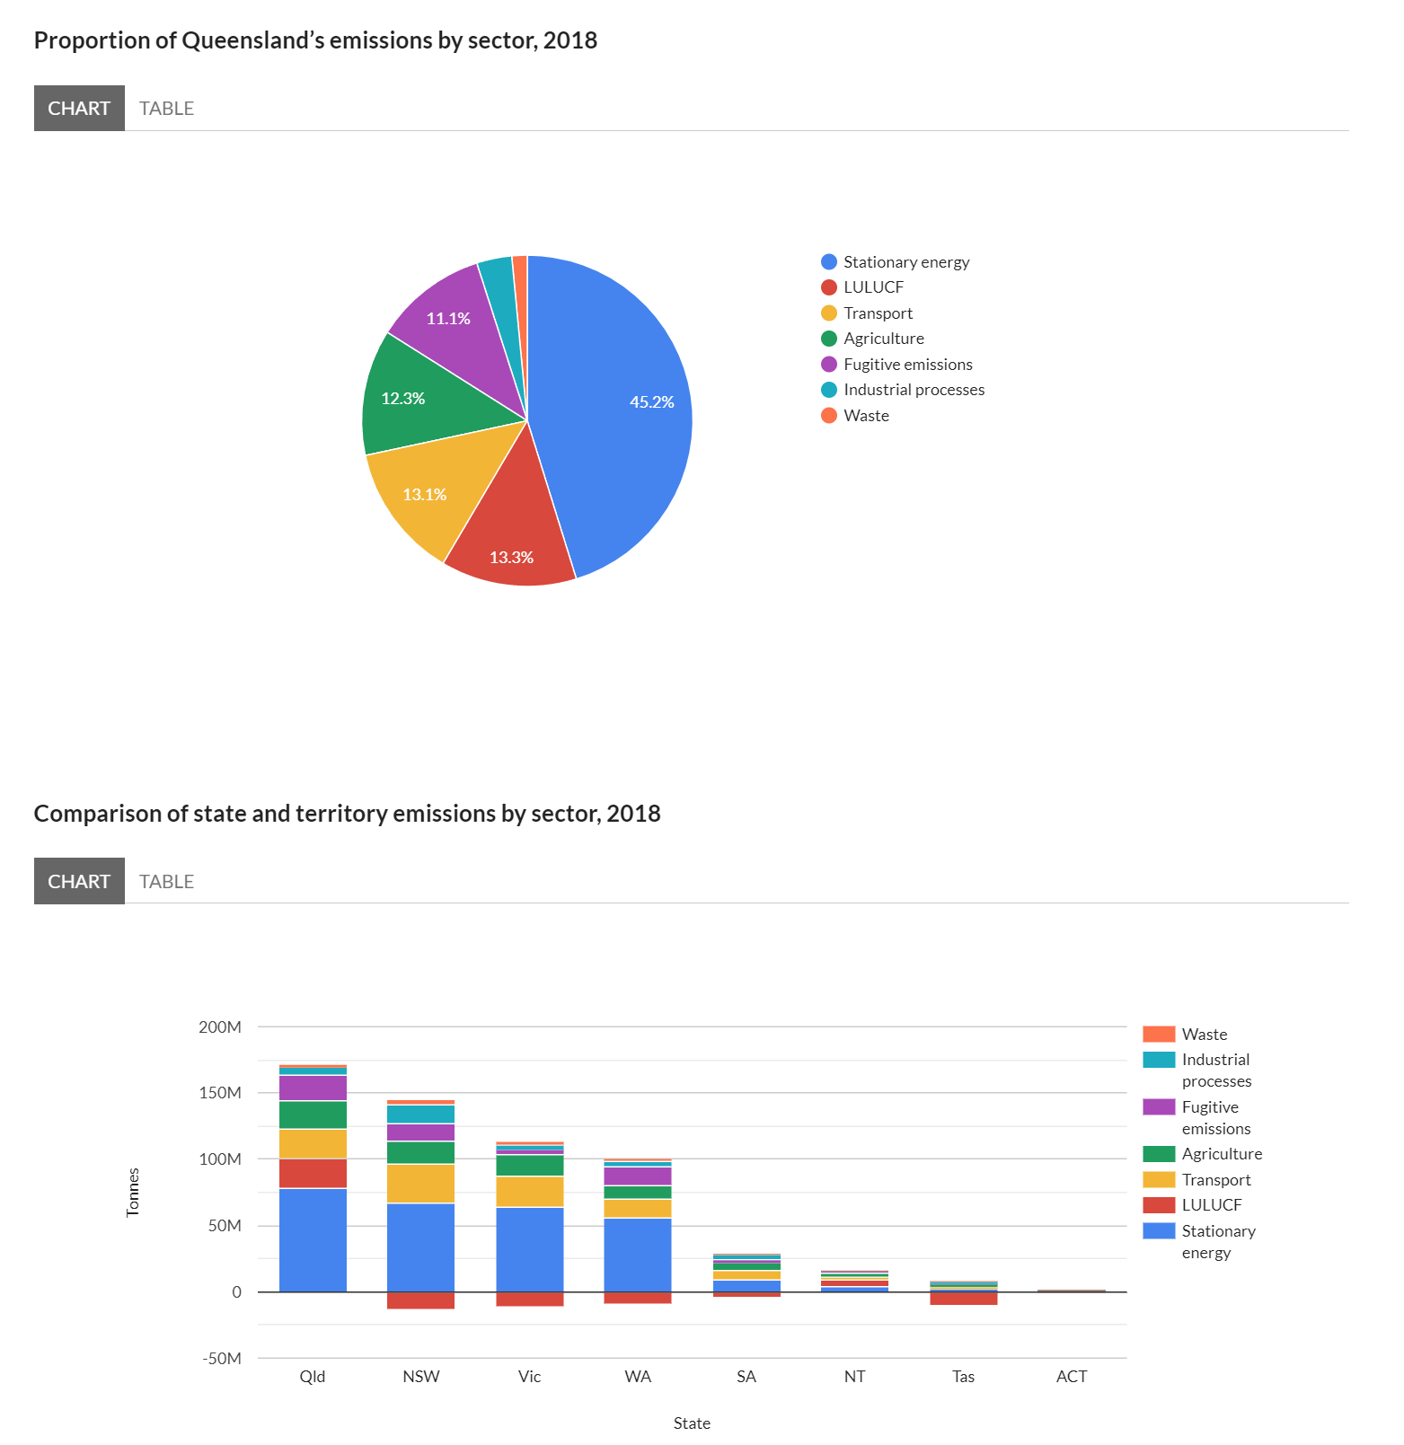
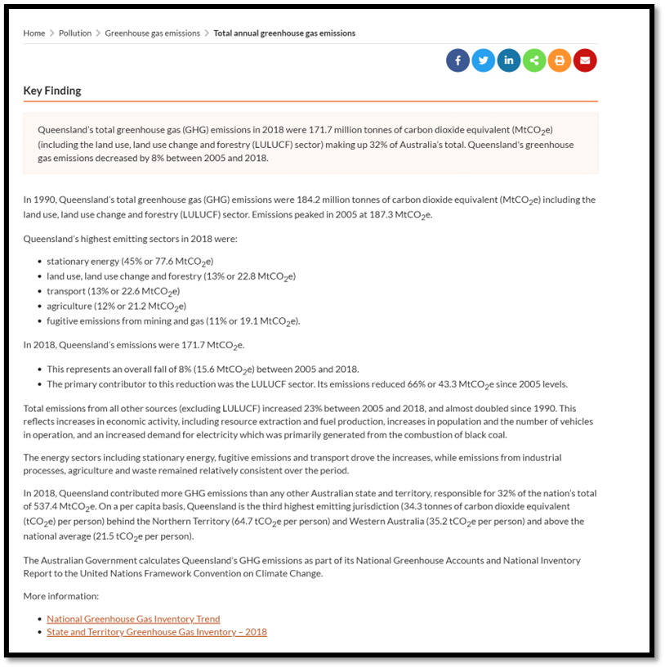
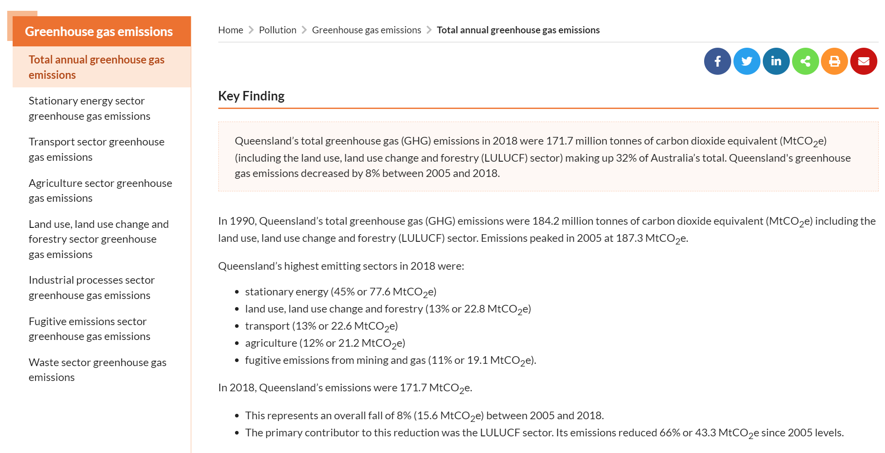
Existing Solution

Slide 13
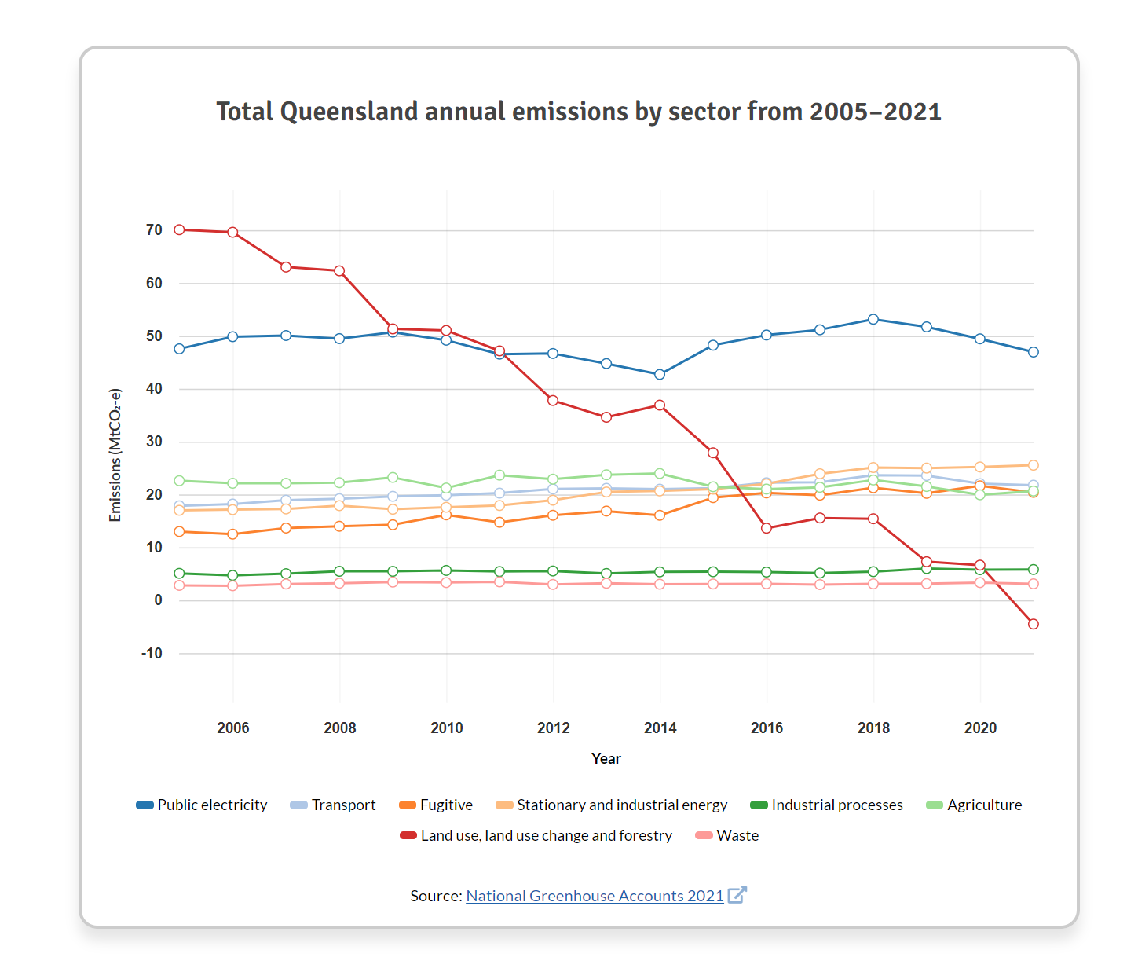
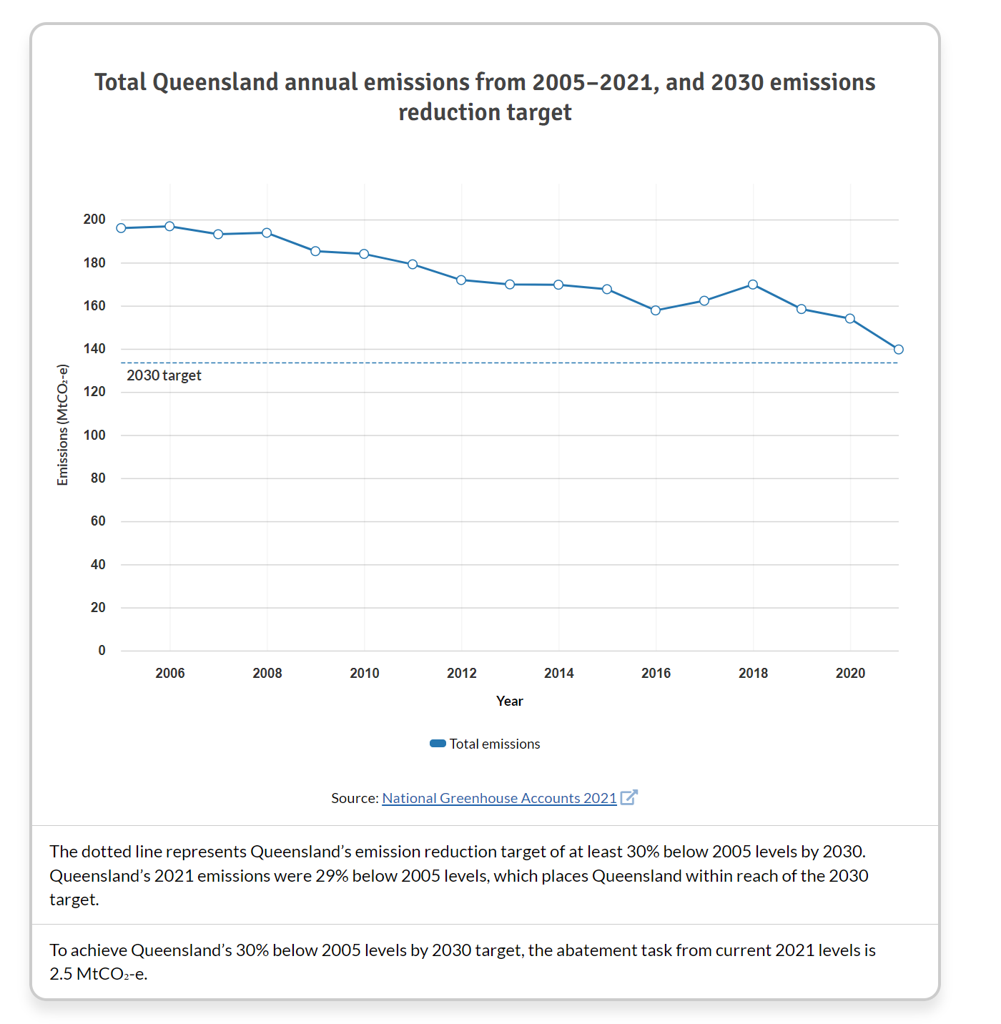
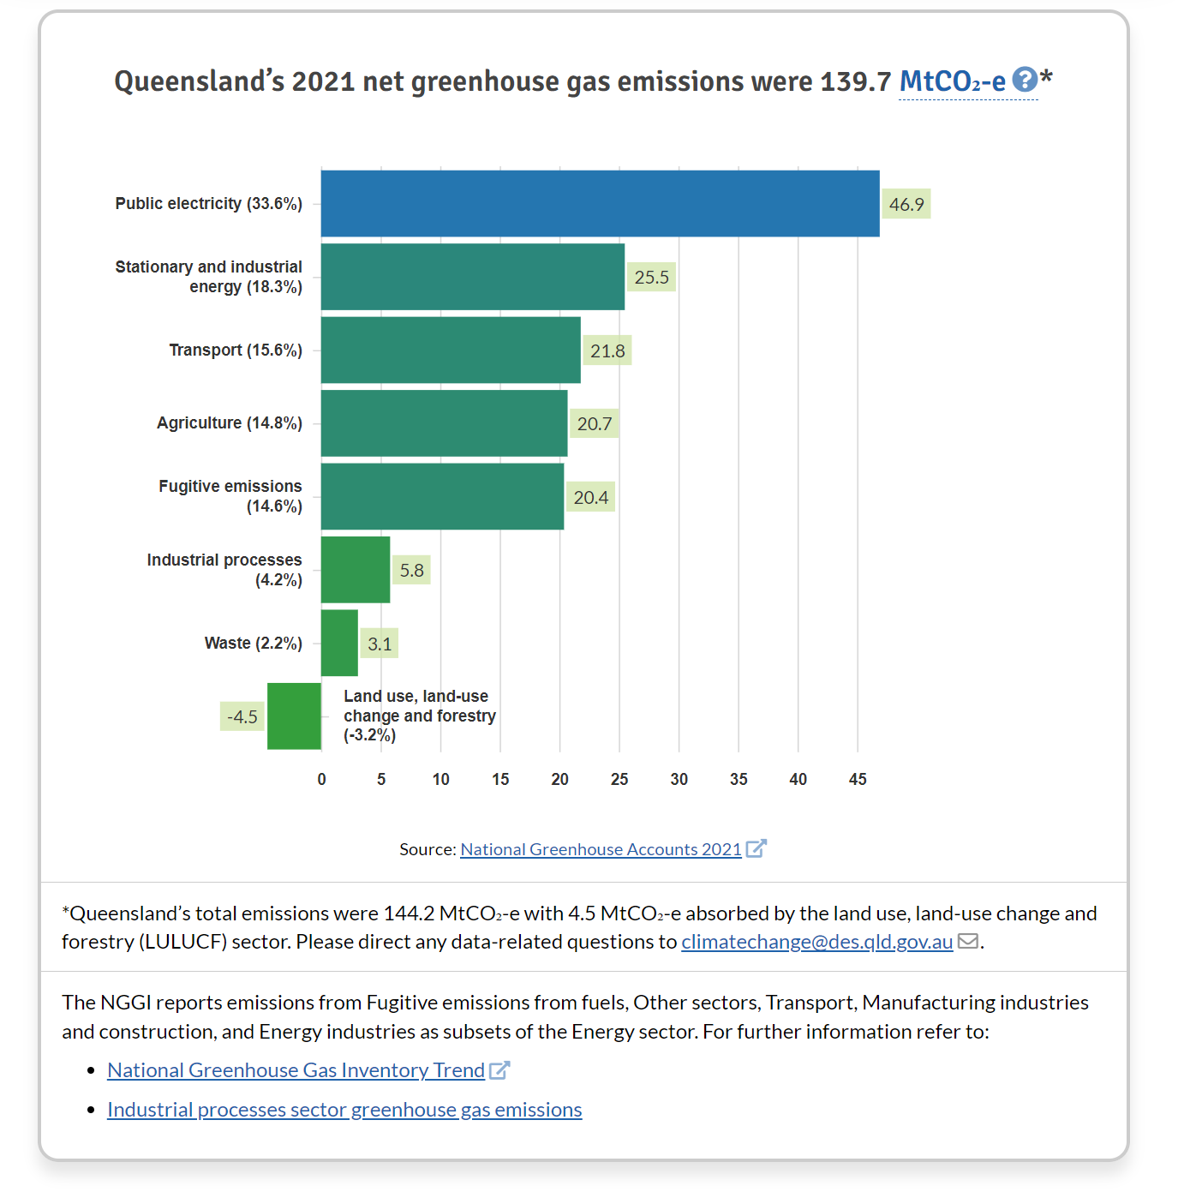
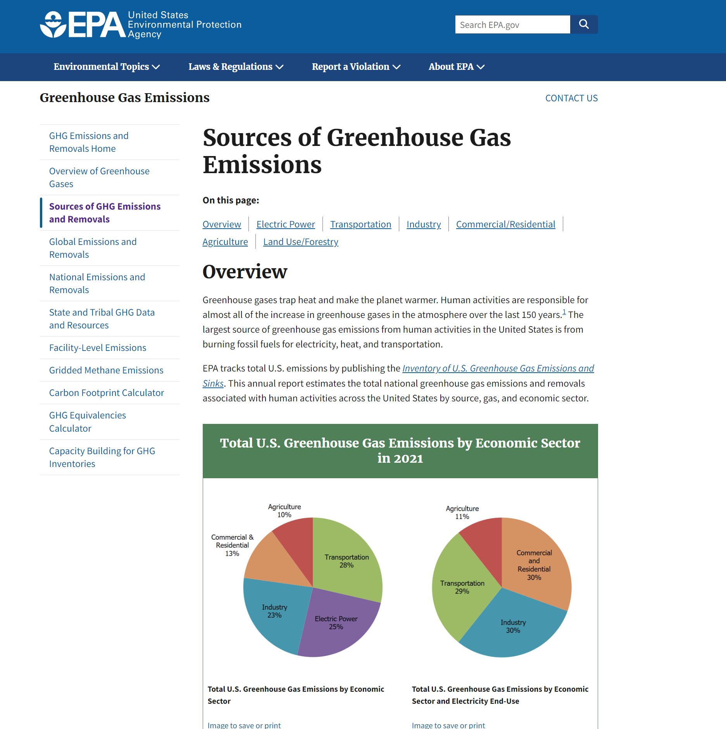
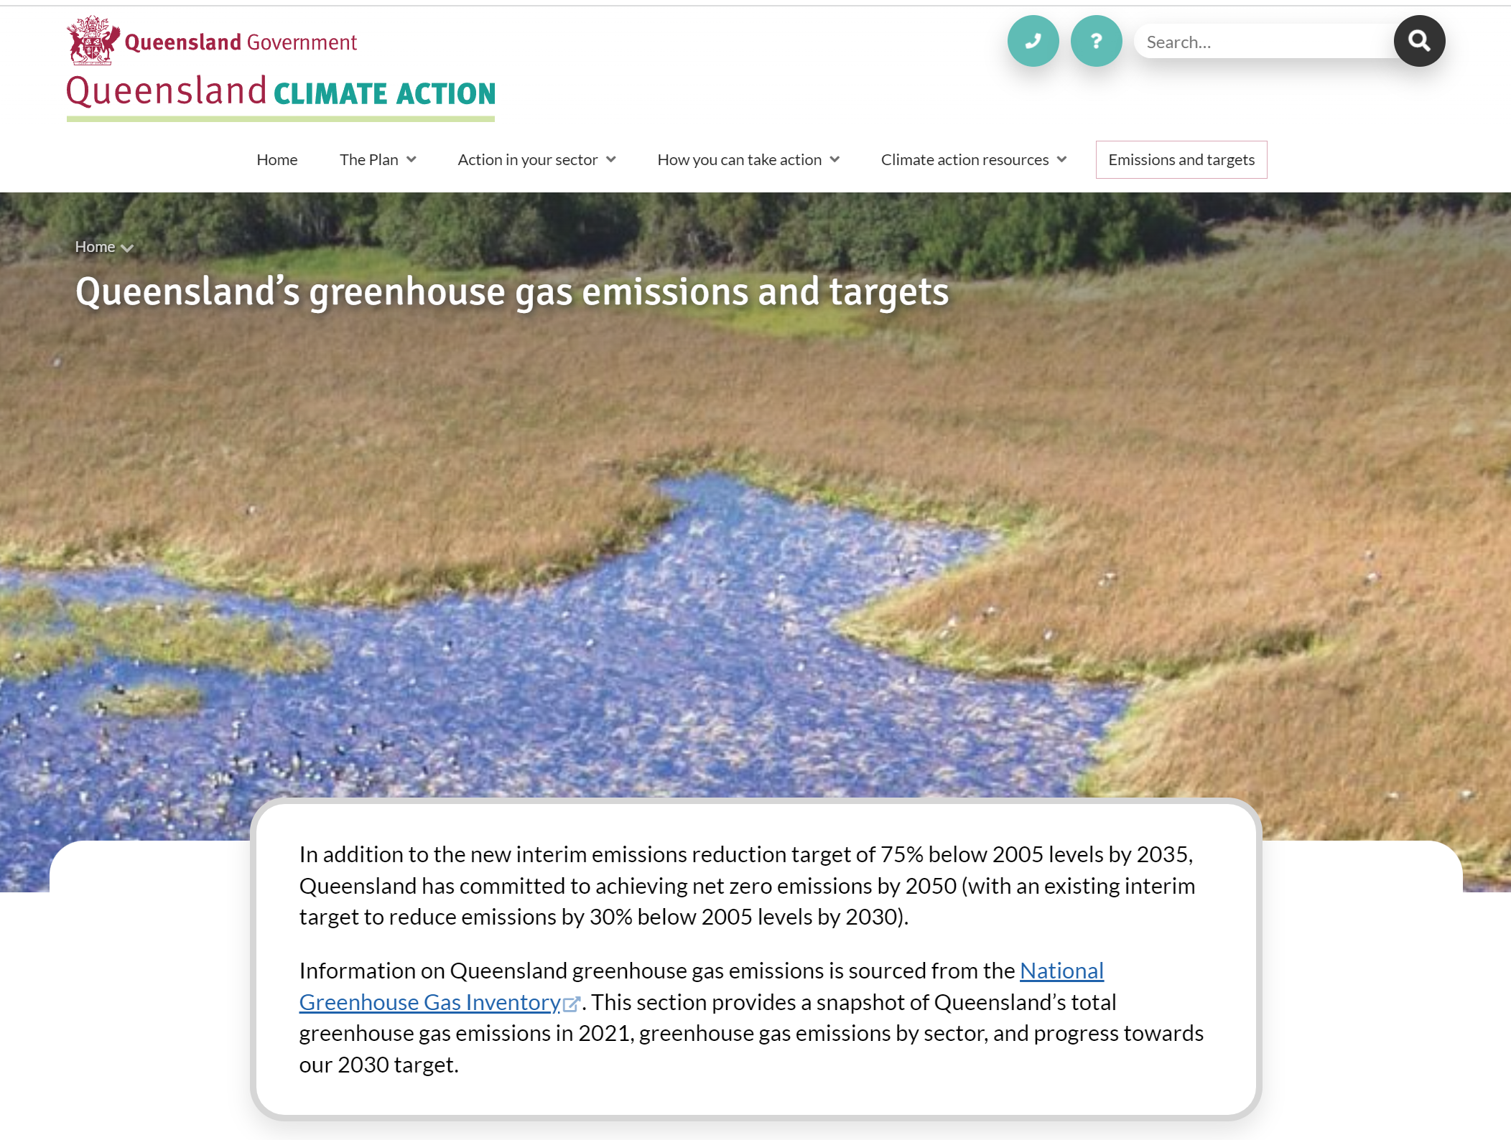
Other Solutions
Science, jurisdiction=Queensland; sector=government; corporateName=Department of E. and. (2021, July 30). Queensland’s 2019 greenhouse gas emissions and targets. Queensland Climate Action. https://www.des.qld.gov.au/climateaction/emissions-targets
‌
Environmental Protection Agency. (2023, October 5). Sources of Greenhouse Gas Emissions. United States Environmental Protection Agency. https://www.epa.gov/ghgemissions/sources-greenhouse-gas-emissions
‌

Slide 14
Data Story

Slide 15
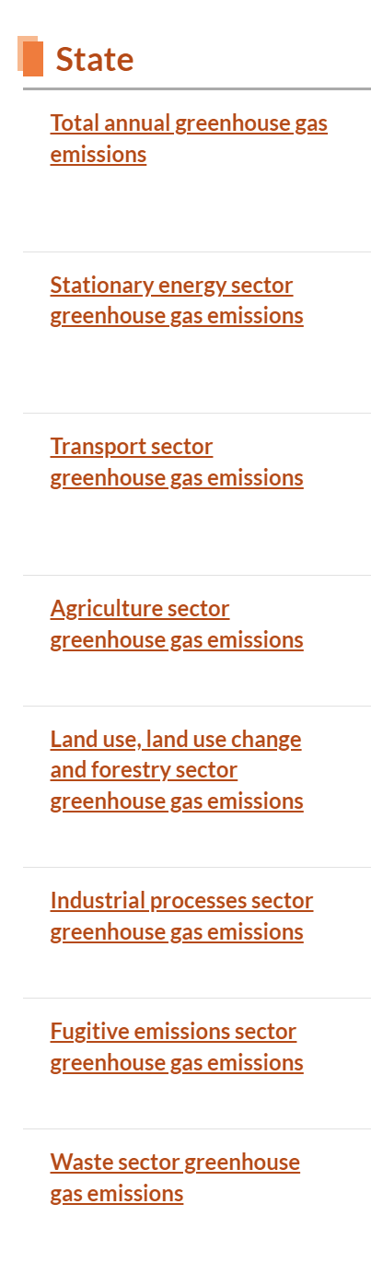
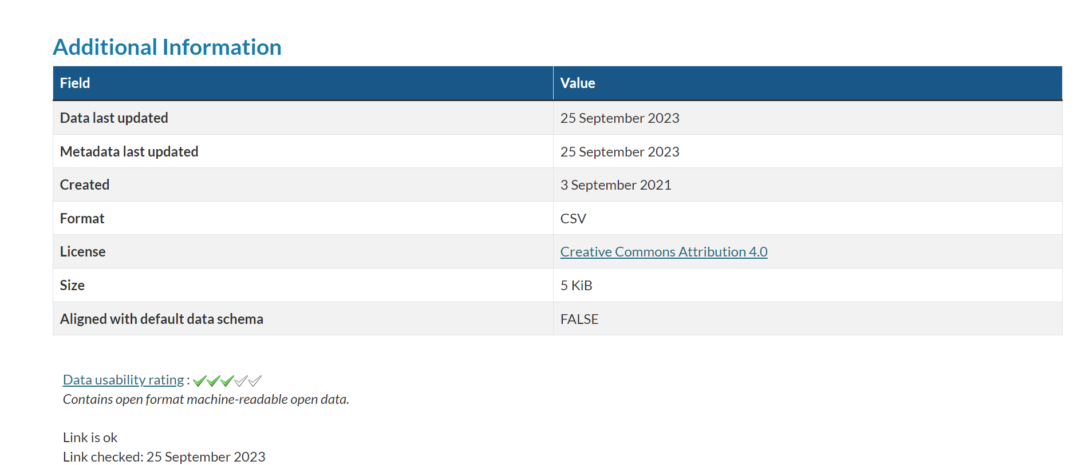
Data Story

Slide 16
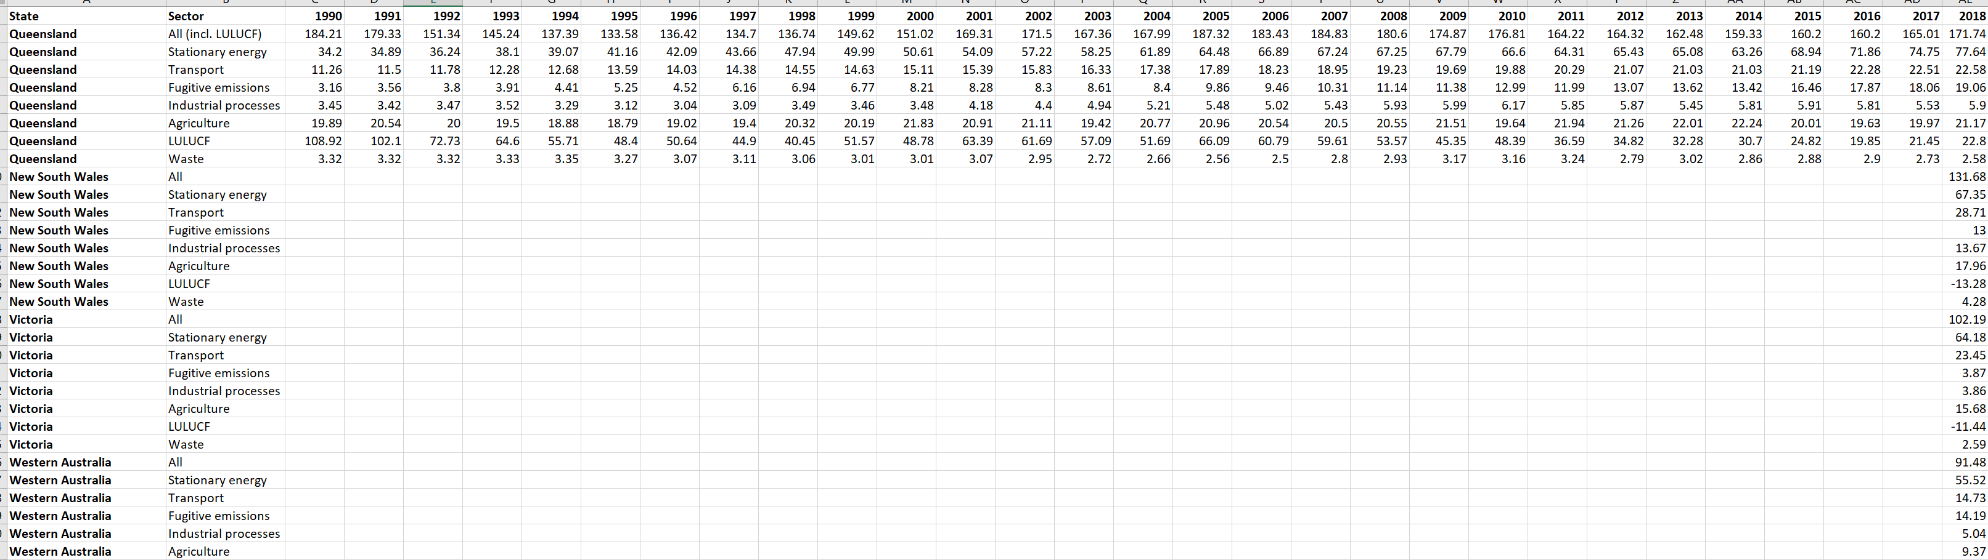
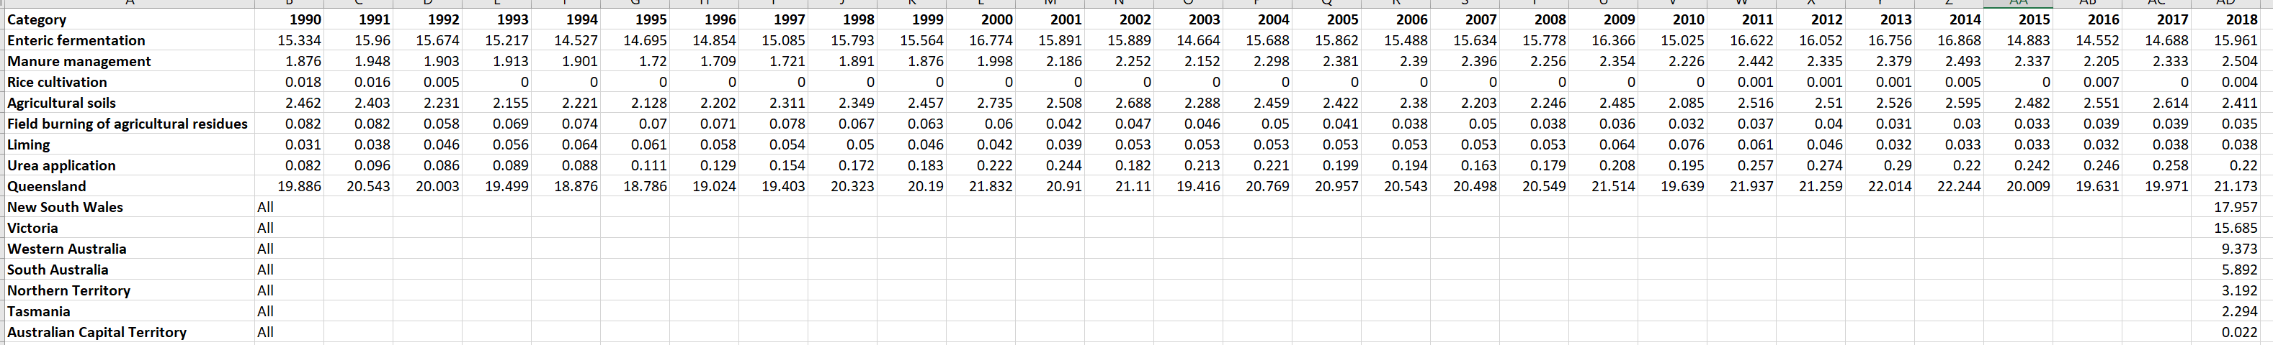
Datasets
Sector Totals:
Agriculture Totals:

Slide 17
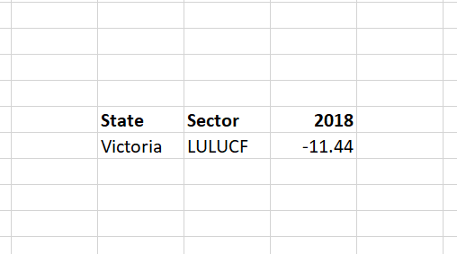
Datasets (Notes)
LULUCF: Land use, land use change and forestry

Slide 18
Data Dictionary
Table: Emissions
Field | Data Type | Validation Rules | Example
Emission | Float(10) | Not Null | 15.5
Year | Int(4) | Not Null | 2018
StateID | Int(2) | Foreign key, Not Null | 1
SectorID | Int(3) | Foreign key, Not Null | 1
CategoryID | Int(5) | Foreign key, Not Null | 3
Table: Sectors
Field | Data Type | Validation Rules | Example
SectorID | Int(3) | Primary key, AUTO_INCREMENT | 1
Sector | Varchar(100) | Not Null | Agriculture
Table: Category
Field | Data Type | Validation Rules | Example
CategoryID | Int(5) | Primary key, AITO_INCREMENT | 1
Category | Varchar(100) | Not Null | Total
Table: Admins
Field | Data Type | Validation Rules | Example
AdminID | Float(4) | Primary key, AUTO_INCREMENT | 0001
Name | Varchar(75) | Not Null | John Smith
Email | Varchar(100) | Not Null | John@gov.au
Telephone | Float(10) | optional | 0412345678
Password | Varchar(500) | Not Null | 5e884898da28047151d0e56f8dc6292773603d0d6aabbdd62a11ef721d1542d8
Table: State
Field | Data Type | Validation Rules | Example
StateID | Int(5) | Primary key, AITO_INCREMENT | 1
State | Varchar(100) | Not Null | QLD

Slide 19
Sample data
Table: Emissions
Table: Sectors
GHG Emissions (Million Tons) | Year | State | Sector | Category
0.082 | 1990 | 2 | 1 | 2
0.039 | 2001 | 2 | 1 | 3
67.35 | 2018 | 3 | 2 | 1
14.73 | 2018 | 4 | 3 | 1
SectorID | Sector
1 | All
2 | Agriculture
3 | Stationary Energy
4 | Transport
Table: Category
CategoryID | Category
1 | Total
2 | Liming
3 | Urea Application
Table: Admins
AdminID | Name | Email | Telephone | Password
0001 | Riley Hampson | rhamp14@eq.edu.au | 0412345678 | 5e884898da28047151d0e56f8dc6292773603d0d6aabbdd62a11ef721d1542d8
0002 | John Doe | johndoe@gov.qld.au | 4012345678 | ef92b778bafe771e89245b89ecbc08a44a4e166c06659911881f383d4473e94f
0003 | Jane Doe | jane@mail.com.au | Null | 567bacc47c4622ca2d56138db548c72dbc7d227876dbec325df4f0a19d131ed9
0004 | Tom Howeth | tom@gov.qld.au | 4087654321 | 07484e32181dcf3e72367631b452a7850fb1b4f7448cd7dea9e1580b66541061
Table: State
StateID | State
1 | QLD
2 | NSW
3 | WA

Slide 20
Proposed Solution

Slide 21




Technical Requirements

Slide 22
Wireframes (Home)
Climate Facts
Clear text establishes the website. Large text used to establish hierarchy.
Easy to access navigation bar located where most nav bar’s are for easy learnability
(Nav Bar)
Colour Contrast and Clear borders used to form hierarchy and split content based on relevance and importance

Slide 23
Wireframes (Charts)
Climate Facts
Base SQL statement:
SELECT Emissions.Emission, Emissions.Year, State.State, Sectors.Sector, Category.Category
FROM Emissions
JOIN State ON Emissions.StateID = State.StateID
JOIN Sectors ON Emissions.SectorID = Sectors.SectorID
JOIN Category ON Emissions.CategoryID = Category.CategoryID
Depending on which option is selected from the drop-down menu, the WHERE clause will be added to the SQL query with the relevant information.
(Nav Bar)
Simple and noncomplex overall UI for easy retrieval of any presented information
Drop Down Menu
Charts placed at top of page so visual data is easy to find

Slide 24
Wireframes (Uploading)
Climate Facts
Simple and user friendly form layout with clear instructions
(Nav Bar)
Data Upload
(Upload link)
Use of colour contrast to indicate action button
File upload link will only allow .csv files for data integrity
Submit

Slide 25
Algorithms
State_totals.php
WHEN “State Totals” Tab is run
BEGIN
CONNECT to mySQL database
IF Connection is false
OUTPUT Error
Exit
ENDIF
SET SQL Query TO “SELECT Emissions.Emission, State.State
FROM Emissions
JOIN State ON Emissions.StateID = State.StateID
WHERE Emissions.Year = 2018 AND
Emissions.CategoryID = 1 AND
Emissions.SectorID = 1”
EXECUTE SQL Query
IF SQL Query NOT NULL
OUTPUT table and table headers
WHILE row = SQL Query result
OUTPUT result into row
ENDWHILE
ELSE
OUTPUT Error
ENDELSE
ENDIF
END
connect.php
BEGIN
SET servern TO server name
SET usern TO username
SET password TO password
SET dbn TO database name
SET connection TO mysqli_connect(servern, usern, password, dbn)
IF connection is false
OUTPUT Error
Exit
ENDIF
END

Slide 26
Prototype

Slide 27
Home
Welcome to Climate Facts
Your Queenslander's portal for all Greenhouse Gas
Emissions Data
Please select a menu to get started!
Climate Facts
HOME | EMISSIONS BY SECTOR | STATE TOTALS | LOGIN

Slide 28
Emissions by Sector
Climate Facts
HOME | EMISSIONS BY SECTOR | STATE TOTALS | LOGIN
Sort by: V
TOTALS
Please select an option to sort by
Agriculture
Stationary energy
LULUCF

Slide 29
Emissions by Sector
Climate Facts
HOME | EMISSIONS BY SECTOR | STATE TOTALS | LOGIN
Agriculture: V

Slide 30
Climate Facts
HOME | EMISSIONS BY SECTOR | STATE TOTALS | LOGIN

Slide 31
Email:
Password:
Climate Facts
HOME | EMISSIONS BY SECTOR | STATE TOTALS | LOGIN
EG: john@mail.com
**********
Login

Slide 32
CSV File:
Climate Facts
HOME | UPLOAD DATA | SIGNOUT
(Click here to upload file)
Upload

Slide 33
CSV File:
Climate Facts
HOME | UPLOAD DATA | SIGNOUT
File: 2019_QLD_GHG_Data.csv
Upload

Slide 34
Successfully Uploaded!
Climate Facts
HOME | UPLOAD DATA | SIGNOUT

Slide 35
Conclusion

Slide 36
Evaluation
Personal – With misinformation prevalent on the internet, displaying information in an easy-to-read and accessible manner allows people of all ages to be informed with correct statistics, allowing them to create make an informed opinion on the topic
Social – People will be able to take correct climate data and interpret it as they see fit, informing the community against misinformation.
Economic – Anyone with a device and an internet connection can access Climate Facts. There is limited economic impact, as the application will be state-hosted utilising data they are already funded to collect. There will be minimal costs such as administration and server hosting.

Slide 37
Criteria Evaluation (Prescribed)
Criteria | Evaluation | Recommendations
Produce a technical proposal for an innovative Digital Solution and present its feasibility through a multimodal presentation | A technical proposal for an innovative digital solution was produced. | nil
Develop a low-fidelity prototype of a responsive web application for the Department of Environment and Science (DES) about greenhouse gas emissions | A low-fidelity prototype of a responsive web application for the DES about greenhouse gas emissions was constructed. This included a Home page, QLD historic sector emissions page, a state totals for 2018, and a data upload page. | More pages and charts could have been implemented
Analyse two datasets provided by DES and determine the most suitable for the web application | The sector totals and agriculture dataset were analysed. The sector totals was determined to be the most suitable for the web application. | All datasets can be used for the web application
Allow Authorised Users (System Administrators) to upload greenhouse gas emissions data | A prototype login system and upload page was developed to allow Authorised users to upload GHG emission data | There needs to be a system to create and delete admin accounts. Different User level access maybe be needed (IE: Moderators, System Admins, Gov Workers)
Be able to generate reports to display sector data and historical totals for Queensland | You are able to generate reports for historic QLD emissions data
Compare Gas emissions between states for 2018 | The state totals page allows users to compare emissions between states | A link to other states emissions websites could be added

Slide 38
Criteria Evaluation (Self Determined)
Criteria | Evaluation | Recommendations
Design a mock-up/prototype user interface (UI) with appropriate accessibility features to ensure accessibility and a good user experience (UX) | A mock-up/prototype UI with appropriate accessibility features was successfully designed with user UX in mind | A magnification tool to scale text for users
Create effective and efficient Algorithms by using selection and iteration to present selected data | Effective and efficient Algorithms that utilised selection and iteration were used to retrieve and display data | nil
Allow Climate data to be uploaded in .csv file format | A data upload page was designed to allow Admins to upload .csv files | Add a guide for how the .csv files should be formatted
Develop a prototype of a normalised 3NF mySQL database with accurate and appropriate Primary and Foreign key Relationships | A prototype normalised 3NF mySQL database was designed with accurate and useful Primary and Foreign key Relationships | A more effective database structure could be designed
Present accurate, relevant data in an easily accessible and unbiased manner | Data is presented in easy-to-read charts and there is no bias or political persuasion. | More types and options of graphs should be available

Slide 39
Bibliography
Environmental Protection Agency. (2023, October 5). Sources of Greenhouse Gas Emissions. United States Environmental Protection Agency. https://www.epa.gov/ghgemissions/sources-greenhouse-gas-emissions
Science, jurisdiction=Queensland; sector=government; corporateName=Department of E. and. (2021, July 30). Queensland’s 2019 greenhouse gas emissions and targets. Queensland Climate Action. https://www.des.qld.gov.au/climateaction/emissions-targets
The State of Queensland. (2017). State of the Environment (Department of Environment and Science). Qld.gov.au. https://www.stateoftheenvironment.des.qld.gov.au/
‌
‌

Slide 40
Thank you!

